Slide 1
Using Big Data To Solve
Economic and Social Problems
Professor Raj Chetty
Head Section Leader Rebecca Toseland
Photo Credit: Florida Atlantic University

Slide 2
Improving Health Outcomes
Research in economics typically focuses on earnings or wealth as key outcomes of interest
But most people view health and life expectancy as among the most important aspects of well-being
What interventions are most effective in improving health (holding fixed current frontier of medical technology)?
Research on these issues spans multiple fields, from epidemiology and public health to economics

Slide 3
Epidemiology and Public Health
One common approach: randomized trials
Ex.: vary exercise regimes and examine impacts on short-term health outcomes
Difficult to implement especially when studying long-term effects
Use observational data to estimate correlations, but many pitfalls
Ex: People who report dieting in a phone survey weighed more on average → dieting counterproductive?

Slide 4
Health Economics: Markets for Healthcare
Health is a very complex market with many non-standard features
1. Patients have private information → asymmetric information
2. Hard for patients to judge quality and decide what to buy
3. Third-party payers (insurance companies) → moral hazard
Escalating costs of healthcare in America (now 17% of GDP)
Particularly timely topic in the context of political debate on Affordable Care Act (Obamacare vs. Trumpcare)

Slide 5
Improving Health Outcomes: Overview
This lecture illustrates how big data is helping us learn how to improve health, in three segments:
Descriptive analysis of health outcomes in U.S. population [method: survival analysis]
Chetty, Stepner, Abraham, Lin, Scuderi, Bergeron, Cutler. “The Association Between Income and Life Expectancy in the United States” JAMA 2016.

Slide 6
Improving Health Outcomes: Overview
This lecture illustrates how big data is helping us learn how to improve health, in three segments:
Descriptive analysis of health outcomes in U.S. population [method: survival analysis]
Epidemiology application: using big data to forecast pandemics [method: predictive modeling]
Ginsberg, Mohebbi, Patel, Brammer, Smolinski, Brilliant. “Detecting Influenza Epidemics Using Search Engine Query Data.” Nature 2009.
Lazer, Kennedy, King, Vespignani. “The Parable of Google Flu: Traps in Big Data Analysis.” Science 2014.

Slide 7
Improving Health Outcomes: Overview
This lecture illustrates how big data is helping us learn how to improve health, in three segments:
Descriptive analysis of health outcomes in U.S. population [method: survival analysis]
Epidemiology application: using big data to forecast pandemics [method: predictive modeling]
Economics applications: impacts of health insurance coverage [method: regression discontinuities]
Wherry, Miller, Kaestner, Meyer. “Childhood Medicaid Coverage and Later Life Health Care Utilization” REStat 2017.

Slide 8
Income and Life Expectancy
Most common measure of health: mortality rates
Crude but well measured in population data
Begin with basic descriptive facts about life expectancy in America
Chetty et al. (2016) examine relationship between life expectancy and income
Use data on entire U.S. population from 1999-2013 (1.4 billion observations)

Slide 9
Estimating Life Expectancy: Data
Mortality measured using Social Security death records
Income measured at household level using tax returns
Focus on percentile ranks in income distribution
Rank individuals in national income distribution within birth cohort, gender, and tax year

Slide 10
Methodology to Estimate Life Expectancy
Goal: estimate expected age of death conditional on an individual’s income at age 40, controlling for differences in race and ethnicity
Period life expectancy: life expectancy for a hypothetical individual who experiences mortality rates at each age observed in a given year
Three steps:
Calculate mortality rates by income rank and age for observed ages
Estimate a survival model to extrapolate to older ages
Adjust for racial differences in mortality rates

Slide 11
Survival Curve for Men at 5th Percentile
100
Age 76
80
60
Survival Rate (%)
40
20
0
40
60
80
100
120
Age in Years (a)

Slide 12
Survival Curves for Men at 5th and 95th Percentiles
100
Age 76
80
60
Survival Rate (%)
40
20
0
40
60
80
100
120
Age in Years (a)

Slide 13
Survival Curves for Men at 5th and 95th Percentiles
100
Age 76
80
p95 Survival Rate: 83%
60
Survival Rate (%)
p5 Survival Rate: 52%
40
20
0
40
60
80
100
120
Age in Years (a)

Slide 14
Step 2: Predicting Mortality Rates at Older Ages
To calculate life expectancy, need estimates of mortality rates beyond age 76
Gompertz (1825) documented a robust empirical pattern: mortality rates grow exponentially with age

Slide 15
Mortality Rates by Gender in the United States in 2001: CDC Data
0
Age 76
-2
Log Mortality Rate
-4
-6
40
50
60
70
80
90
100
Age in Years
Men
Women

Slide 16
Log Mortality Rates for Men at 5th and 95th Percentiles
-2
-4
Log Mortality Rate
-6
-8
40
50
60
70
80
90
Age in Years
Data: p5
Gompertz: p5
Data: p95
Gompertz: p95

Slide 17
Log Mortality Rates for Men at 5th and 95th Percentiles
-2
Age 65
-4
Log Mortality Rate
-6
Medicare Eligibility
Threshold
-8
40
50
60
70
80
90
Age in Years
Data: p5
Gompertz: p5
Data: p95
Gompertz: p95

Slide 18
Survival Curves for Men at 5th and 95th Percentiles
100
Age 76
Age 90
80
60
Survival Rate (%)
40
20
Gompertz
Extrapolation
0
40
60
80
100
120
Age in Years (a)
Data: p5
Gompertz: p5
Data: p95
Gompertz: p95

Slide 19
Survival Curves for Men at 5th and 95th Percentiles
100
Age 76
Age 90
80
60
Survival Rate (%)
40
NCHS and SSA
Estimates
(constant across
20
income groups)
Gompertz
Extrapolation
0
40
60
80
100
120
Age in Years (a)
Data: p5
Gompertz: p5
Data: p95
Gompertz: p95

Slide 20
Race and Ethnicity Adjustment
CDC data: for males, life expectancy of whites is 3.8 years higher than blacks and 2.7 years lower than Hispanics
Adjust for such racial and ethnic differences as follows:
Use National Longitudinal Mortality Study to estimate racial and ethnic differences in mortality rates by age, controlling for income
Use Census data to construct race- and ethnicity-adjusted estimates of life expectancy, to answer the question:
“What would life expectancy be if each income group and area had the same black, Hispanic and Asian shares as the U.S. population as a whole at age 40?”

Slide 21
National Statistics on Income and Life Expectancy

Slide 22
Expected Age at Death vs. Household Income Percentile
For Men at Age 40
90
85
Expected Age at Death for 40 Year Olds in Years
80
75
70
0
20
$25k
40
$47k
60
$74k
80
$115k
100
$2.0M
Household Income Percentile

Slide 23
Expected Age at Death vs. Household Income Percentile
For Men at Age 40
90
Top 1%:
87.3 Years
85
Expected Age at Death for 40 Year Olds in Years
80
75
Bottom 1%:
72.7 Years
70
0
20
$25k
40
$47k
60
$74k
80
$115k
100
$2.0M
Household Income Percentile

Slide 24
U.S. Life Expectancies by Percentile in Comparison to
Mean Life Expectancies Across Countries
United States - P100
San Marino
United States - P50
Canada
United Kingdom
United States - P25
China
Libya
Pakistan
United States - P1
Sudan
Iraq
India
Zambia
Lesotho
60
65
70
75
80
85
90
Expected Age at Death for 40 Year Old Men

Slide 25
Expected Age at Death vs. Household Income Percentile
By Gender at Age 40
90
Women
85
Men
Expected Age at Death for 40 Year Olds in Years
80
75
Women, Bottom 1%: 78.8
Women, Top 1%: 88.9
Men, Bottom 1%: 72.7
70
Men, Top 1%: 87.3
0
20
40
60
80
100
Household Income Percentile

Slide 26
Expected Age at Death vs. Household Income Percentile
By Gender at Age 40
90
Top 1% Gender Gap
1.6 years
85
Expected Age at Death for 40 Year Olds in Years
80
75
Bottom 1% Gender Gap
6.1 years
Women, Bottom 1%: 78.8
Women, Top 1%: 88.9
Men, Bottom 1%: 72.7
70
Men, Top 1%: 87.3
0
20
40
60
80
100
Household Income Percentile

Slide 27
Time Trends
How are gaps in life expectancy changing over time?

Slide 28
Trends in Expected Age at Death by Income Quartile in the US
For Men Age 40, 2001-2014
90
Annual Change = 0.20 (0.17, 0.24)
85
Annual Change = 0.18 (0.15, 0.20)
Expected Age at Death for 40 Year Olds in Years
Annual Change = 0.12 (0.08, 0.16)
80
Annual Change = 0.08 (0.05, 0.11)
75
2000
2005
2010
2015
Year
1st Quartile
2nd Quartile
3rd Quartile
4th Quartile

Slide 29
Trends in Expected Age at Death by Income Quartile in the US
For Women Age 40, 2001-2014
90
Annual Change = 0.23 (0.20, 0.25)
88
Annual Change = 0.25 (0.22, 0.28)
Expected Age at Death for 40 Year Olds in Years
Annual Change = 0.17 (0.13, 0.20)
86
84
Annual Change = 0.10 (0.06, 0.13)
82
2000
2005
2010
2015
Year
1st Quartile
2nd Quartile
3rd Quartile
4th Quartile

Slide 30
Local Area Variation in Life Expectancy by Income

Slide 31
Expected Age at Death vs. Household Income
for Men in Selected Cities
90
85
80
New York City
San Francisco
Dallas
75
Detroit
70
0
25
50
75
100
$30k
$60k
$101k
$683k
Household Income Percentile

Slide 32
Expected Age at Death vs. Household Income
for Women in Selected Cities
90
85
New York City
San Francisco
80
Dallas
Detroit
75
70
0
50
75
100
$27k
$54k
$95k
$653k
Household Income Percentile

Slide 33
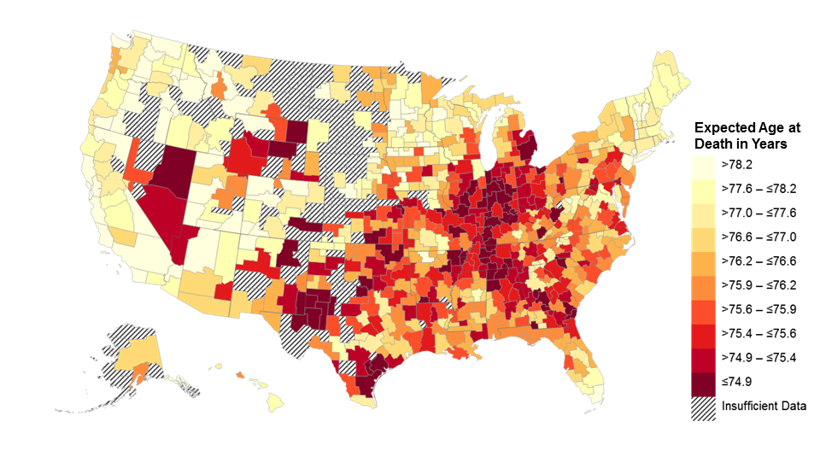
Expected Age at Death for 40 Year Old Men
Bottom Quartile of U.S. Income Distribution
Note: Lighter Colors Represent Areas with Higher Life Expectancy

Slide 34
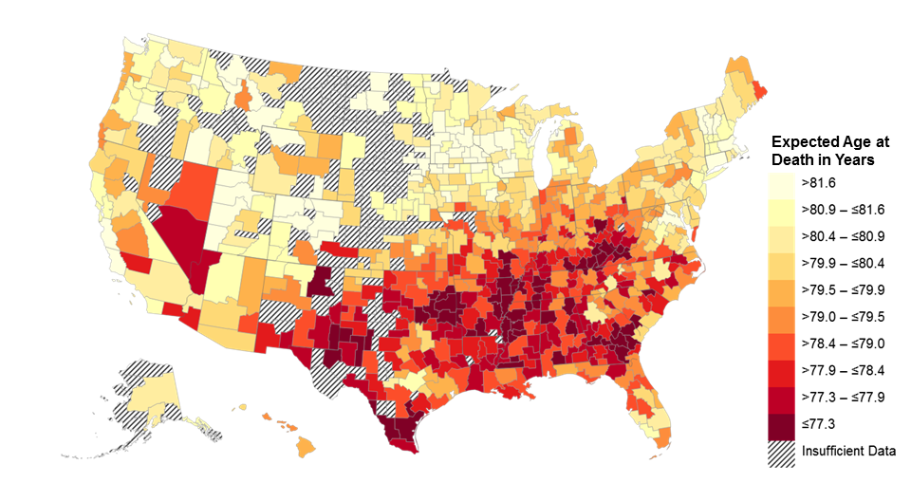
Expected Age at Death for 40 Year Old Men
Pooling All Income Groups
Note: Lighter Colors Represent Areas with Higher Life Expectancy

Slide 35
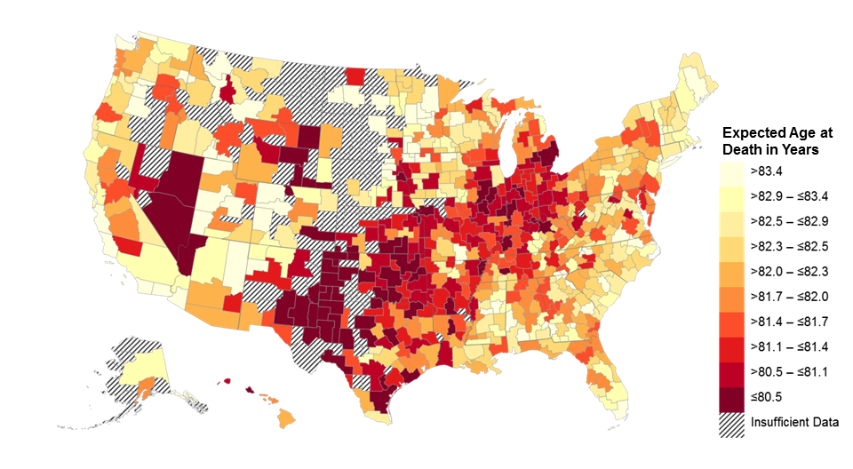
Expected Age at Death for 40 Year Old Women
Bottom Quartile of U.S. Income Distribution
Note: Lighter Colors Represent Areas with Higher Life Expectancy

Slide 36
Expected Age at Death for 40 Year Olds in Bottom Quartile
Top 10 and Bottom 10 CZs Among 100 Largest CZs
Top 10 CZs |  |  |  |  | Bottom 10 CZs
Rank | CZ |  | Expected Age at Death |  | Rank | CZ | Expected Age at Death
1 | New York, NY |  | 81.8 (81.6, 82.0) |  | 91 | San Antonio, TX | 78.0 (77.6, 78.4)
2 | Santa Barbara, CA |  | 81.7 (81.3, 82.1) |  | 92 | Louisville, KY | 77.9 (77.7, 78.2)
3 | San Jose, CA |  | 81.6 (81.2, 82.0) |  | 93 | Toledo, OH | 77.9 (77.6, 78.2)
4 | Miami, FL |  | 81.2 (80.9, 81.6) |  | 94 | Cincinnati, OH | 77.9 (77.7, 78.1)
5 | Los Angeles, CA |  | 81.1 (80.9, 81.4) |  | 95 | Detroit, MI | 77.7 (77.5, 77.8)
6 | San Diego, CA |  | 81.1 (80.8, 81.4) |  | 96 | Tulsa, OK | 77.6 (77.4, 77.9)
7 | San Francisco, CA |  | 80.9 (80.6, 81.3) |  | 97 | Indianapolis, IN | 77.6 (77.4, 77.8)
8 | Santa Rosa, CA |  | 80.8 (80.5, 81.2) |  | 98 | Oklahoma City, OK | 77.6 (77.3, 77.8)
9 | Newark, NJ |  | 80.7 (80.5, 80.9) |  | 99 | Las Vegas, NV | 77.6 (77.4, 77.8)
10 | Port St. Lucie, FL |  | 80.7 (80.5, 80.9) |  | 100 | Gary, IN | 77.4 (77.1, 77.8)
Note: 95% confidence intervals shown in parentheses

Slide 37
Local Area Variation in Trends
Next, analyze how trends in life expectancy vary across areas

Slide 38
Change in Expected Age at Death in Bottom Quartile
Birmingham, AL
90
Annual Change = 0.37 (0.20, 0.55)
85
Expected Age at Death in Years
80
75
Annual Change = 0.20 (0.07, 0.35)
70
2001
2014
Year
Men
Women

Slide 39
Change in Expected Age at Death in Bottom Quartile
Birmingham, AL
Tampa, FL
90
Annual Change = 0.37 (0.20, 0.55)
Annual Change = -0.18 (-0.30, -0.06)
85
Women
Expected Age at Death in Years
80
Men
75
Annual Change = 0.20 (0.07, 0.35)
Annual Change = -0.16 (-0.25, -0.07)
70
2001
2014
2001
2014
Year
Men
Women

Slide 40
Change in Expected Age at Death in Bottom Quartile
Top 10 and Bottom 10 CZs Among 100 Largest CZs
Top 10 CZs |  |  |  | Bottom 10 CZs
Rank | CZ | Change over Decade |  | Rank | CZ | Change over Decade
1 | Toms River, NJ | 3.8 (2.4, 5.2) |  | 91 | Cape Coral, FL | -0.7 (-2.1, 0.6)
2 | Birmingham, AL | 2.9 (1.8, 4.1) |  | 92 | Miami, FL | -0.7 (-1.4, -0.1)
3 | Richmond, VA | 2.6 (1.3, 3.9) |  | 93 | Tucson, AZ | -0.7 (-2.0, 0.5)
4 | Syracuse, NY | 2.5 (1.1, 4.0) |  | 94 | Albuquerque, NM | -0.8 (-2.2, 0.6)
5 | Cincinnati, OH | 2.4 (1.5, 3.4) |  | 95 | Sarasota, FL | -0.8 (-2.0, 0.3)
6 | Fayetteville, NC | 2.4 (1.0, 3.8) |  | 96 | Des Moines, IA | -1.0 (-3.0, 0.8)
7 | Springfield, MA | 2.3 (0.6, 4.1) |  | 97 | Bakersfield, CA | -1.2 (-2.8, 0.3)
8 | Gary, IN | 2.2 (0.8, 3.8) |  | 98 | Knoxville, TN | -1.2 (-2.6, 0.1)
9 | Scranton, PA | 2.1 (0.8, 3.4) |  | 99 | Pensacola, FL | -1.5 (-3.0, -0.2)
10 | Honolulu, HI | 2.1 (0.5, 3.8) |  | 100 | Tampa, FL | -1.7 (-2.5, -0.9)
Note: 95% confidence intervals shown in parentheses

Slide 41
Correlates of Spatial Variation in Life Expectancy

Slide 42
Why Does Life Expectancy Vary Across Areas?
Finally, we characterize the features of areas with high vs. low life expectancy conditional on income

Slide 43
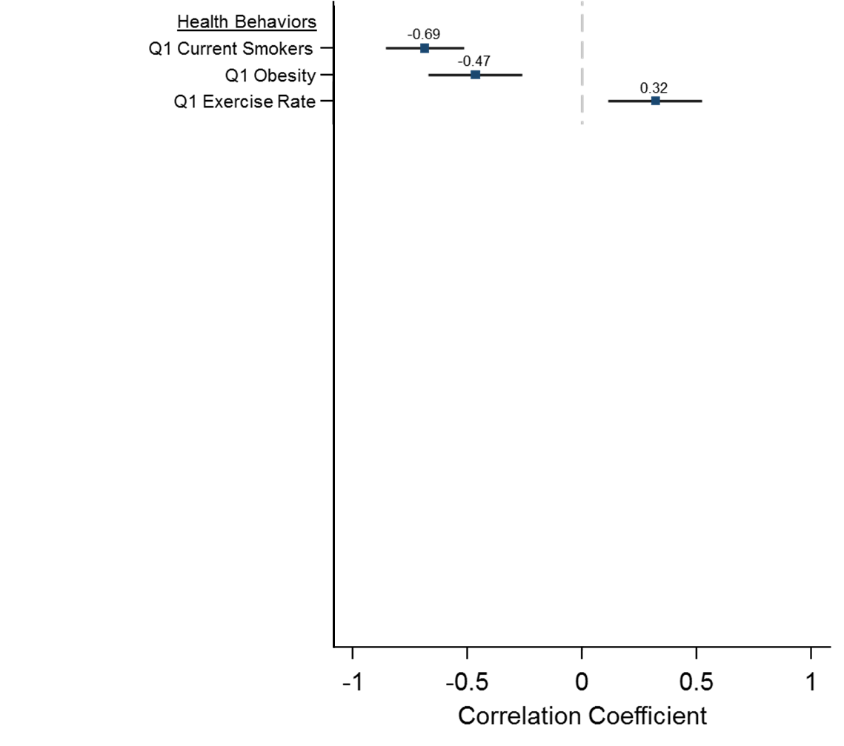
Correlations of Expected Age at Death with Health and Social Factors
For Individuals in Bottom Quartile of Income Distribution

Slide 44
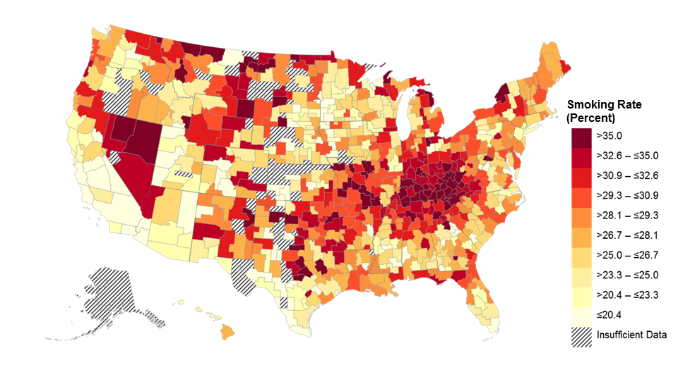
Smoking Rates for Individuals in Bottom Income Quartile
Note: Lighter Colors Represent Areas Lower Smoking Rates

Slide 45
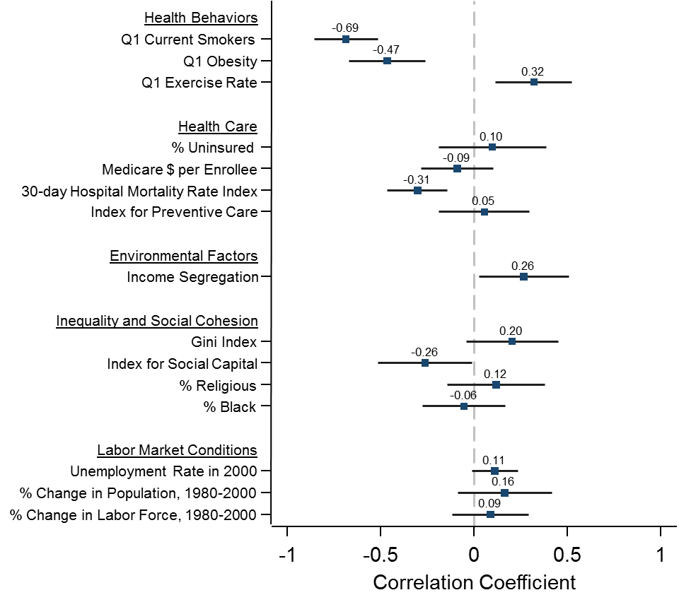
Correlations of Expected Age at Death with Health and Social Factors
For Individuals in Bottom Quartile of Income Distribution

Slide 46
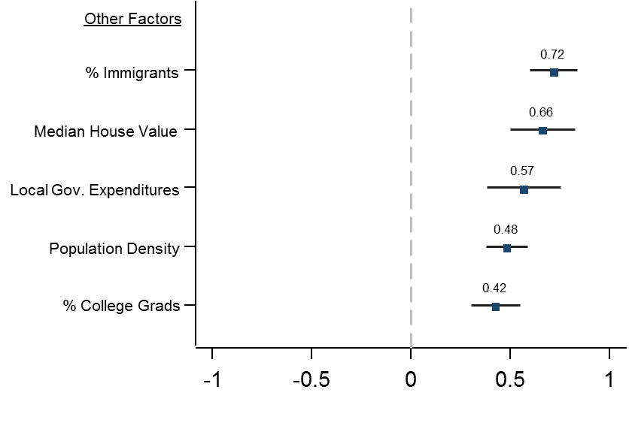
Correlations of Expected Age at Death with Other Factors
For Individuals in Bottom Quartile of Income Distribution

Slide 47
Correlations: Summary
General pattern: Low-income people in affluent, educated cities live longer (and have healthier behaviors)
Why is this the case?
Spillovers from rich to poor: regulation, public revenues/transfers
Exposure to people with healthier behaviors
Sorting: low-income people who live in expensive cities are a selected group with different characteristics

Slide 48
Income and Life Expectancy: Lessons
Disparities in life expectancy are large and growing, but not immutable:
Some areas in the U.S. have relatively small and shrinking gaps
Reducing health disparities likely to require local interventions
Ex: targeted efforts to improve health among low-income individuals in specific cities such as Las Vegas and Detroit
Changing health behaviors at local level likely to be important
Trends imply that indexing eligibility for Social Security and Medicare to average life expectancy will amplify inequality

Slide 49
How Can We Improve Population Health?
Two types of approaches, with different questions and methods:
Public health interventions to change behaviors such as smoking, exercise, water quality, and spread of diseases
Provision of health care and health insurance
Illustrate frontier of research using big data in each of these areas using recent examples

Slide 50
Forecasting Pandemics
Classic problem in population health: forecasting and preventing health pandemics
Contagious diseases like flu spread exponentially → large returns to taking action quickly when disease emerges
Most common method to monitor contagious diseases in developed countries: aggregated data from local clinics
Problem: slow reporting and small samples → data not very fine-grained

Slide 51
Forecasting Pandemics: Google Flu Trends
Ginsberg et al. (2009) propose a new data source to monitor spread of the flu: Google search data
Idea: people often search for terms like “antibiotics” or “how to treat cough” when getting sick
Use aggregated search data to get predictions of spread of flu that are (a) more timely and (b) available at fine geographies

Slide 52
Forecasting Pandemics: Google Flu Trends
Method: predictive modeling
Get historical data on truth from CDC and estimate a statistical model using Google search data to predict that data
Then evaluate the model using future data that was not used for estimation to evaluate model’s predictive accuracy

Slide 53
Google Flu Trends: Methodology
Data to be predicted: 1,152 observations from CDC on flu incidence
Weekly data from 9 regions of the U.S. from 2004-2007
Data used for prediction: counts of Google search data
Weekly data on Google search counts for 50 million terms by state from 2004-2007

Slide 54
Google Flu Trends: Overfitting Problem
This is an example of “wide data”
Many more variables than number of observations
Overfitting problem: can fit the data perfectly using 1,152 explanatory variables → cannot use traditional statistical methods like regression
Solve this problem using out-of-sample validation
Idea: use separate samples to estimate the model and evaluate its predictive accuracy

